Slide 1
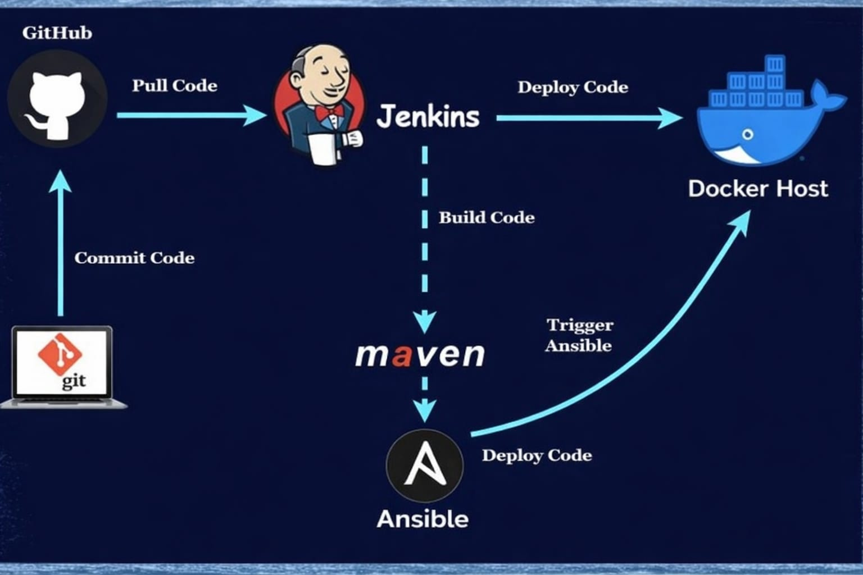
Project 4: CI/CD using Jenkins + Maven + Ansible + Docker Architecture Overview

Slide 2
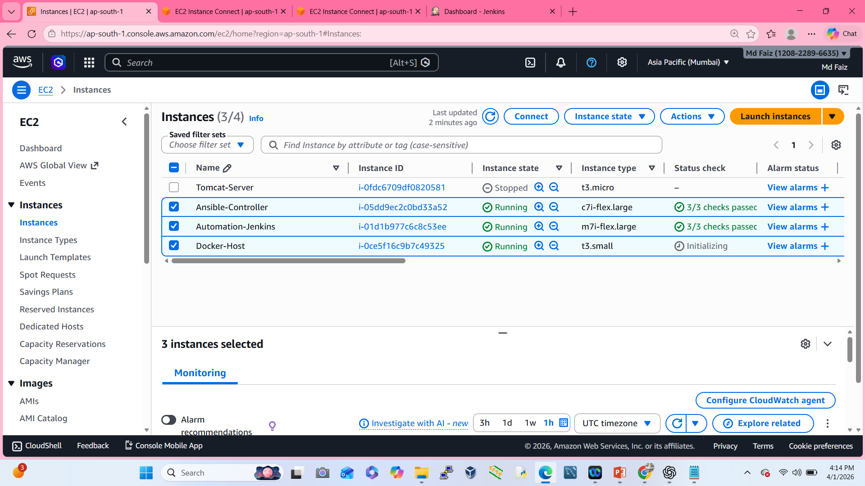
Create Three EC2 Instance Server
Ansible-Controller (Amazon Linux)
Automation-Jenkins (Amazon Linux)
Docker-Host (Ubuntu Linux)

Slide 3
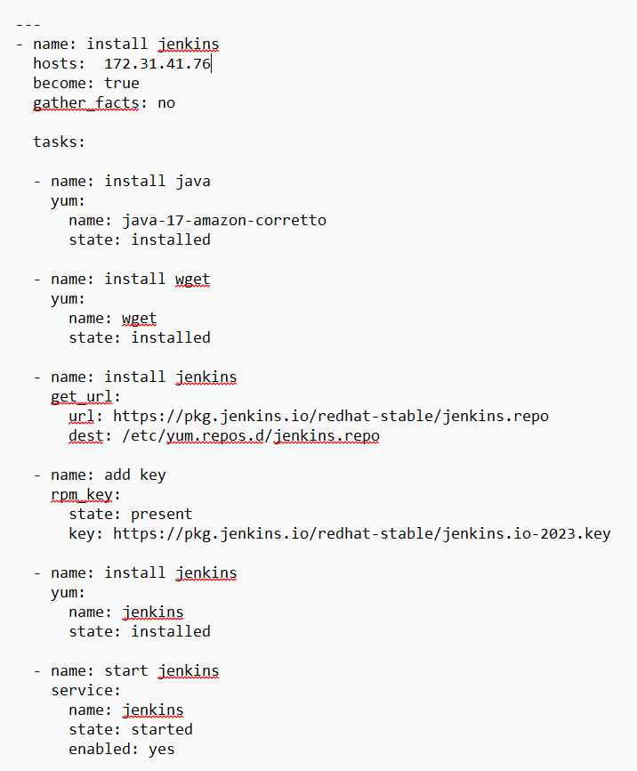
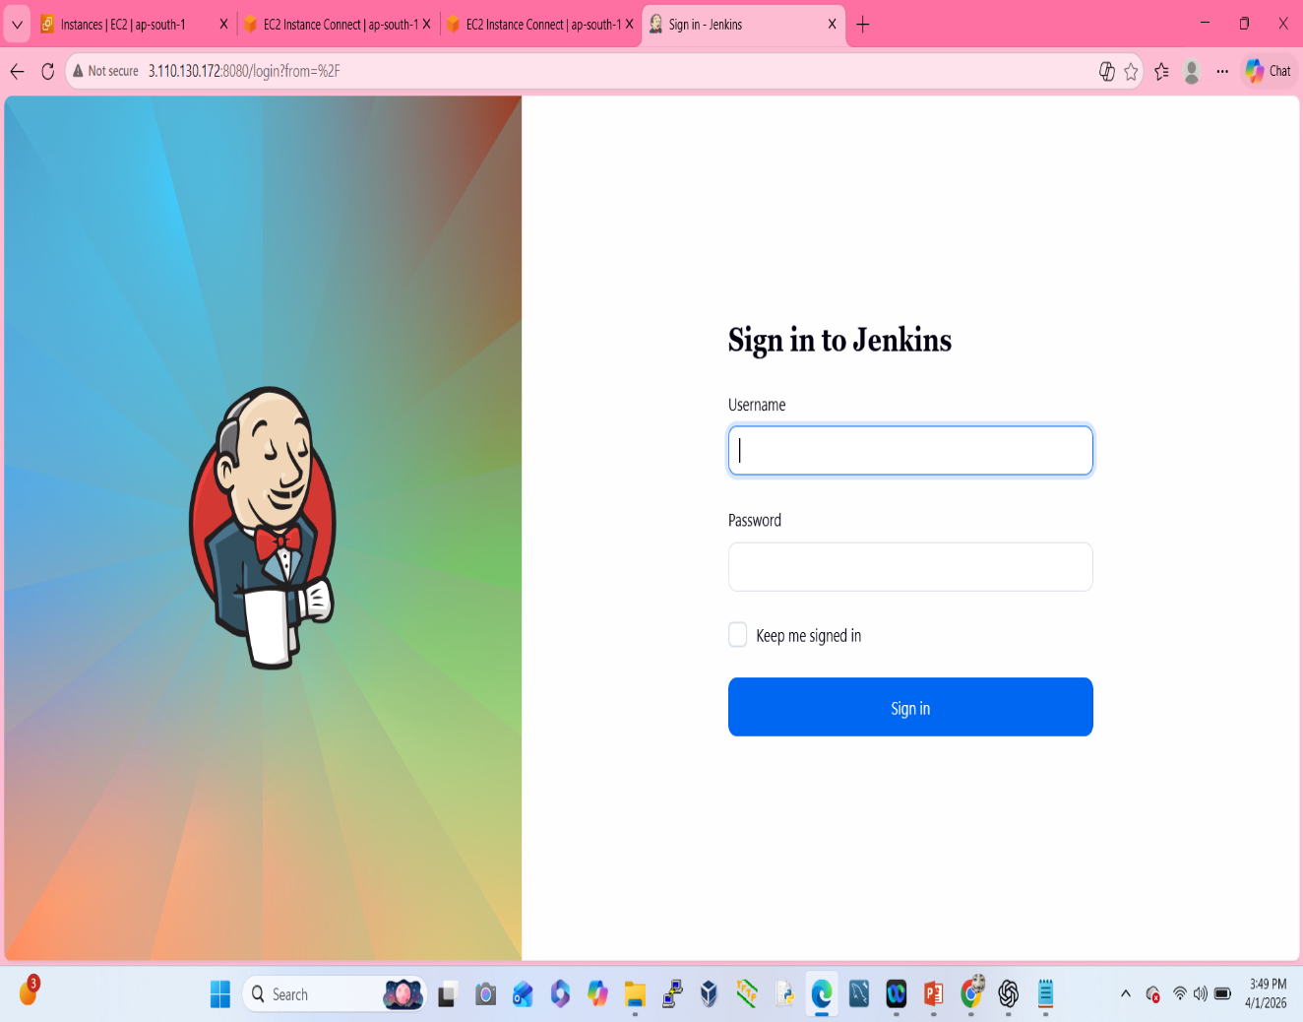
Install Jenkins using Ansible

Slide 4
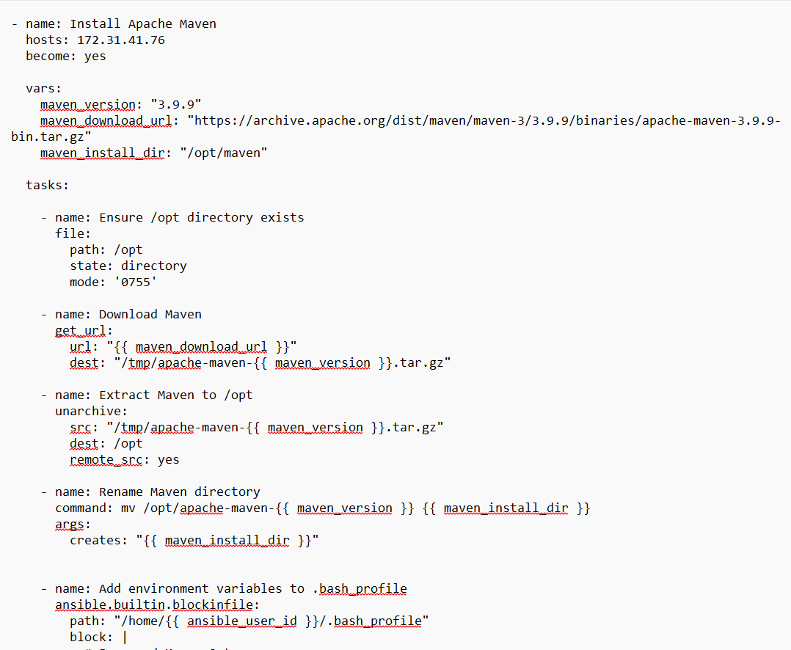
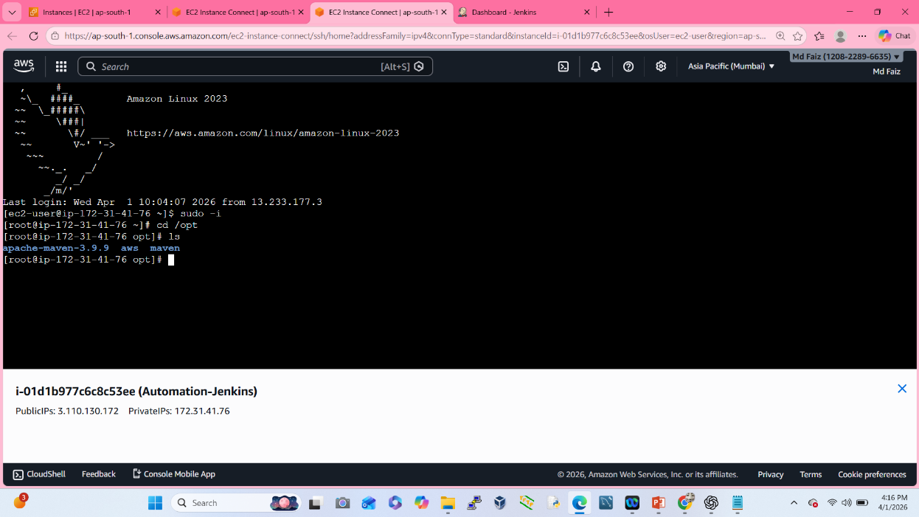
Install Maven using Ansible

Slide 5
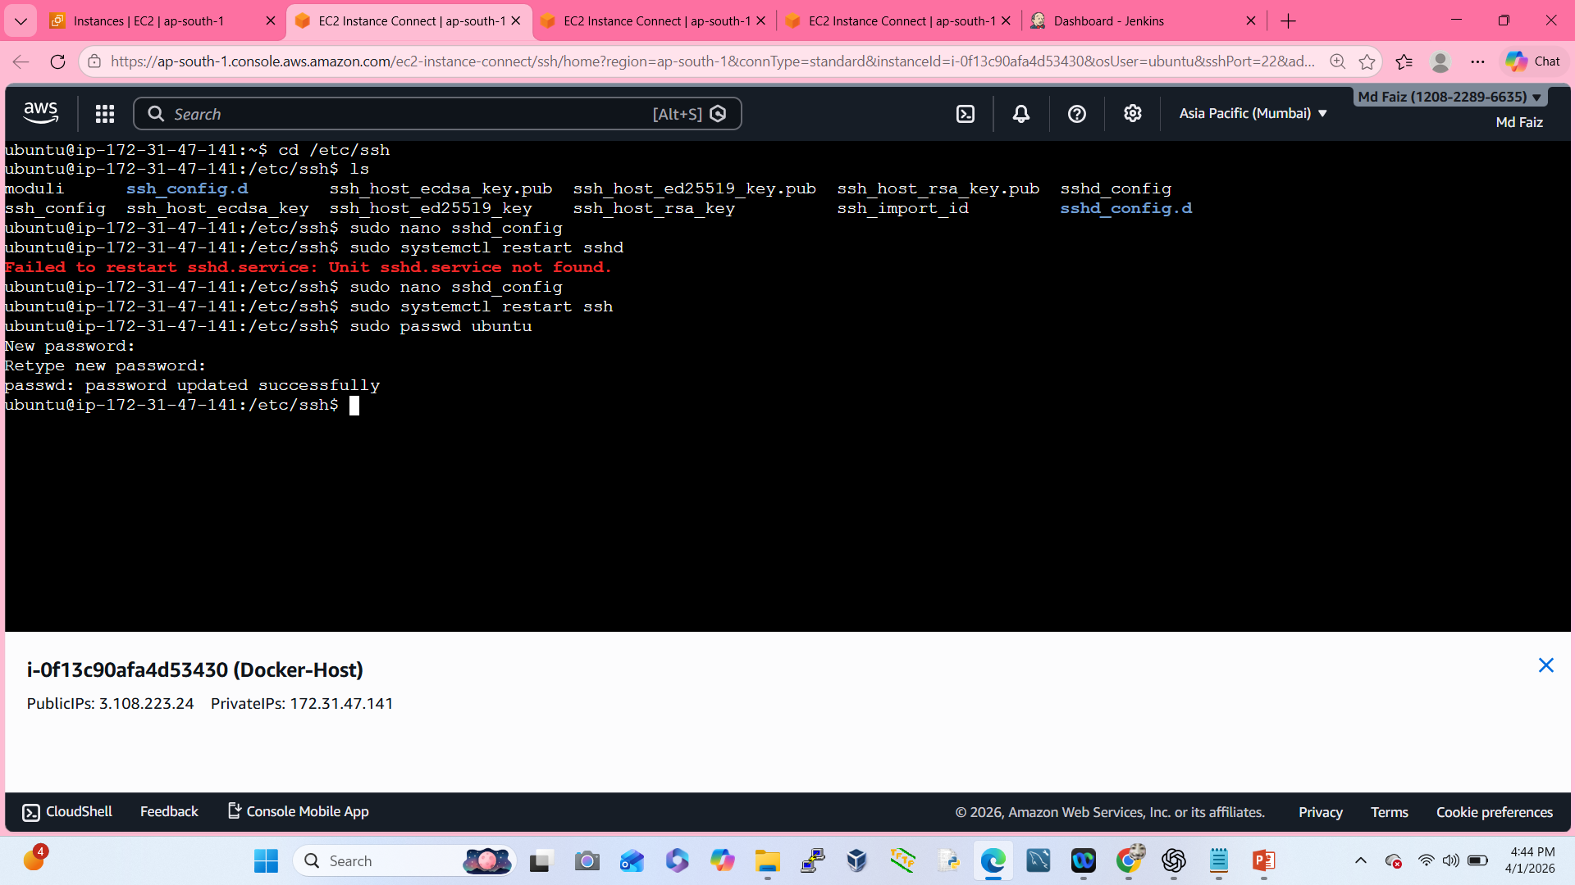
Configure Password Authentication on Ubuntu Server

Slide 6
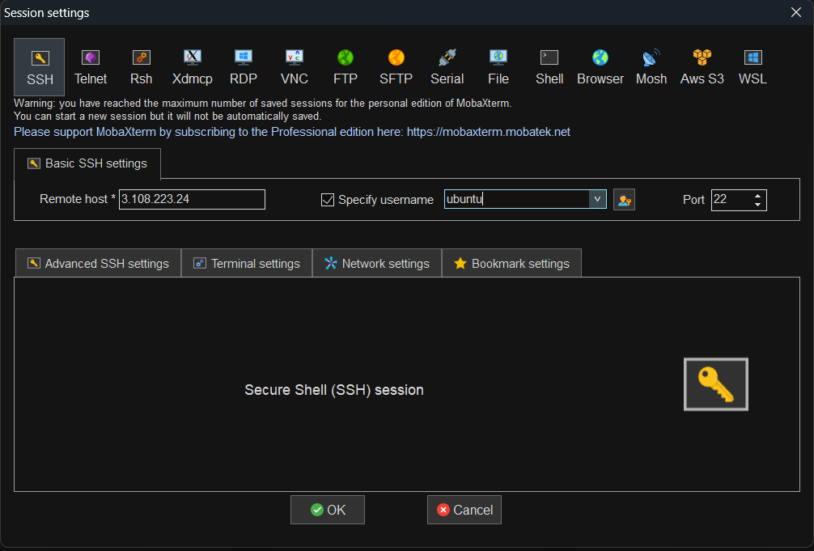
Login to Docker Host Server using MobaXterm
Basic Command Used Here
sudo apt update && sudo apt-get update
sudo apt install docker.io
sudo usermod –aG docker Ubuntu
sudo hostname Docker-Host
sudo nano /etc/hostname
sudo init 6
sudo chown -R ubuntu:Ubuntu /opt
cd /opt
mkdir Docker
sudo chown -R ubuntu:ubuntu /opt/Docker

Slide 7
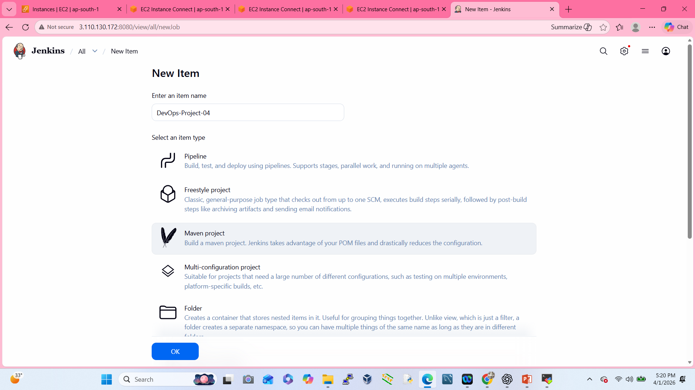
Go to the Jenkins Dashboard

Slide 8
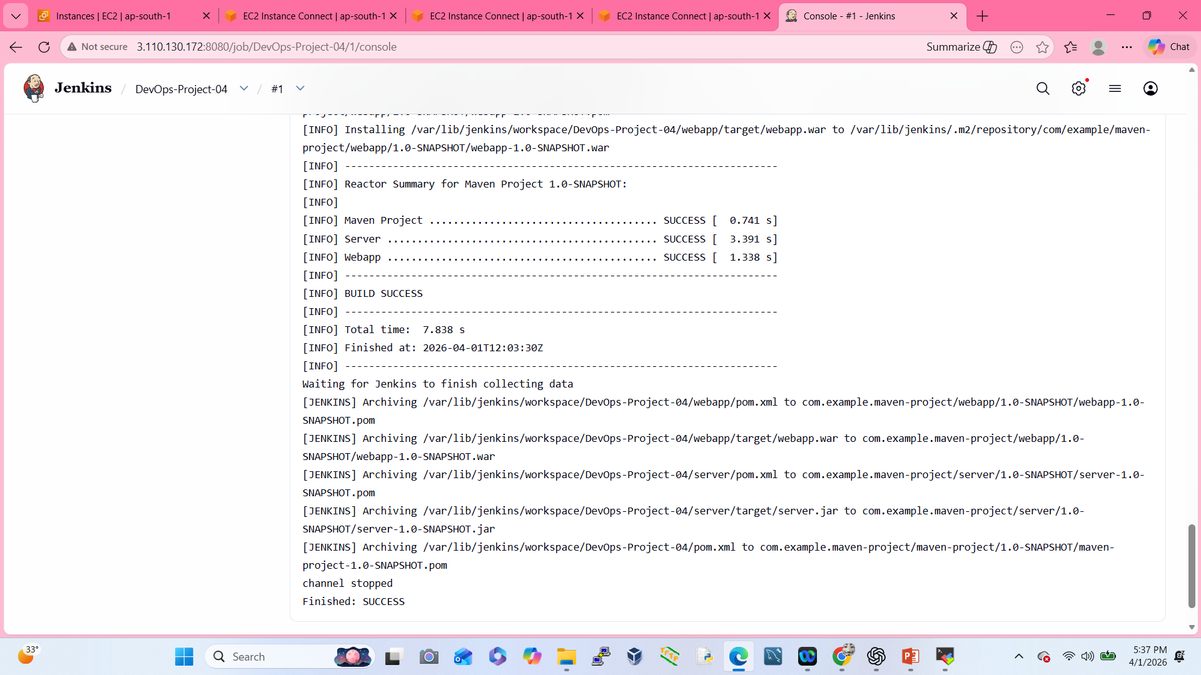
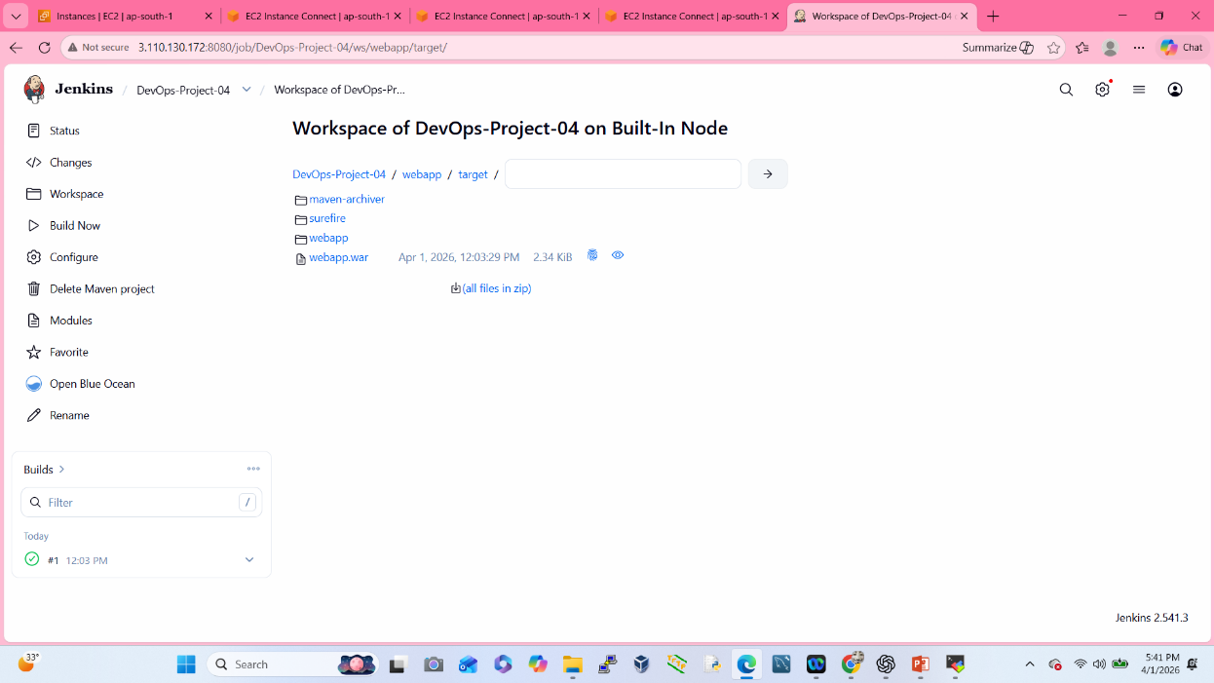
Test the Maven Build

Slide 9
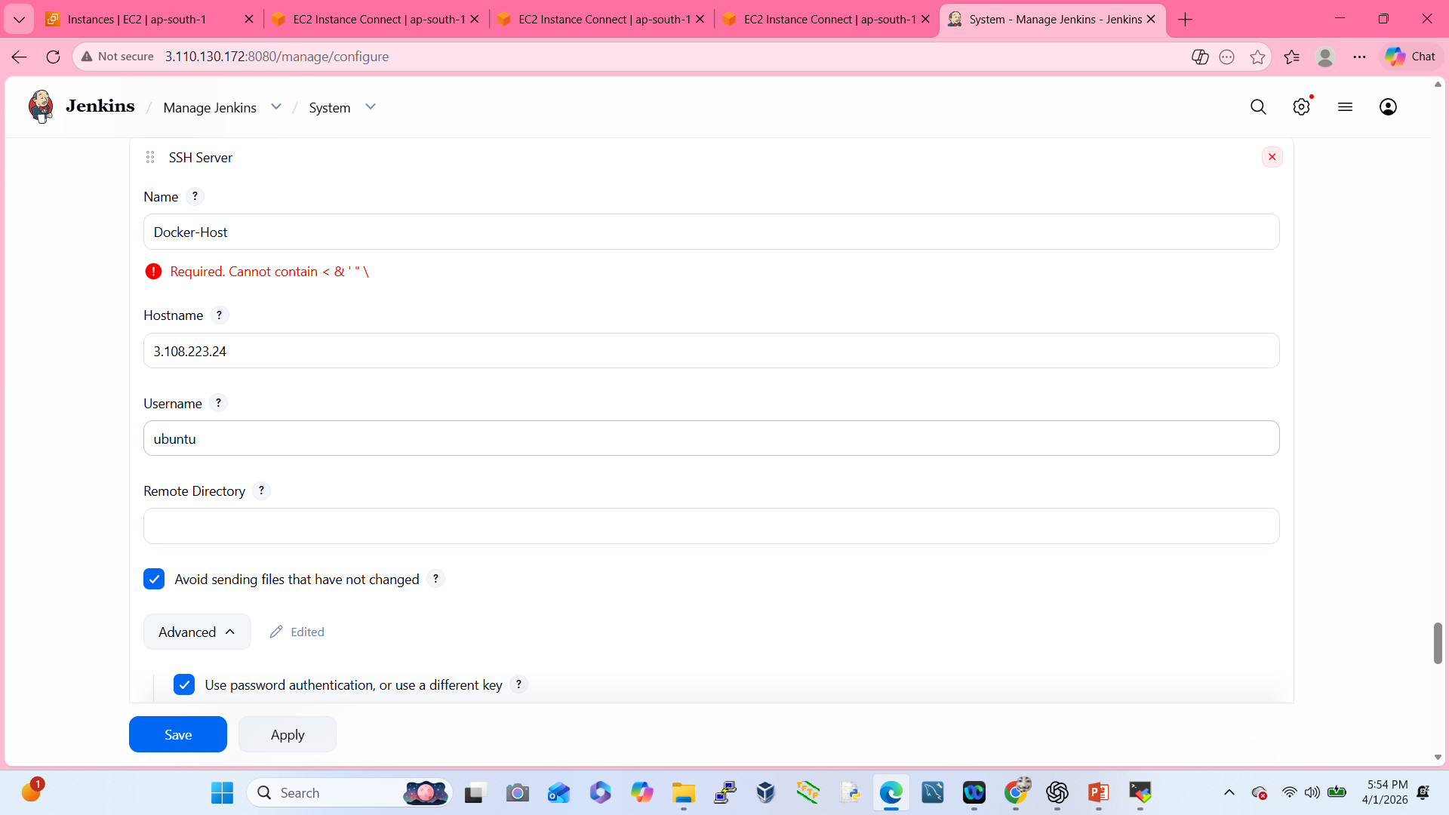
Connect Jenkins Server with Docker-Host Server

Slide 10
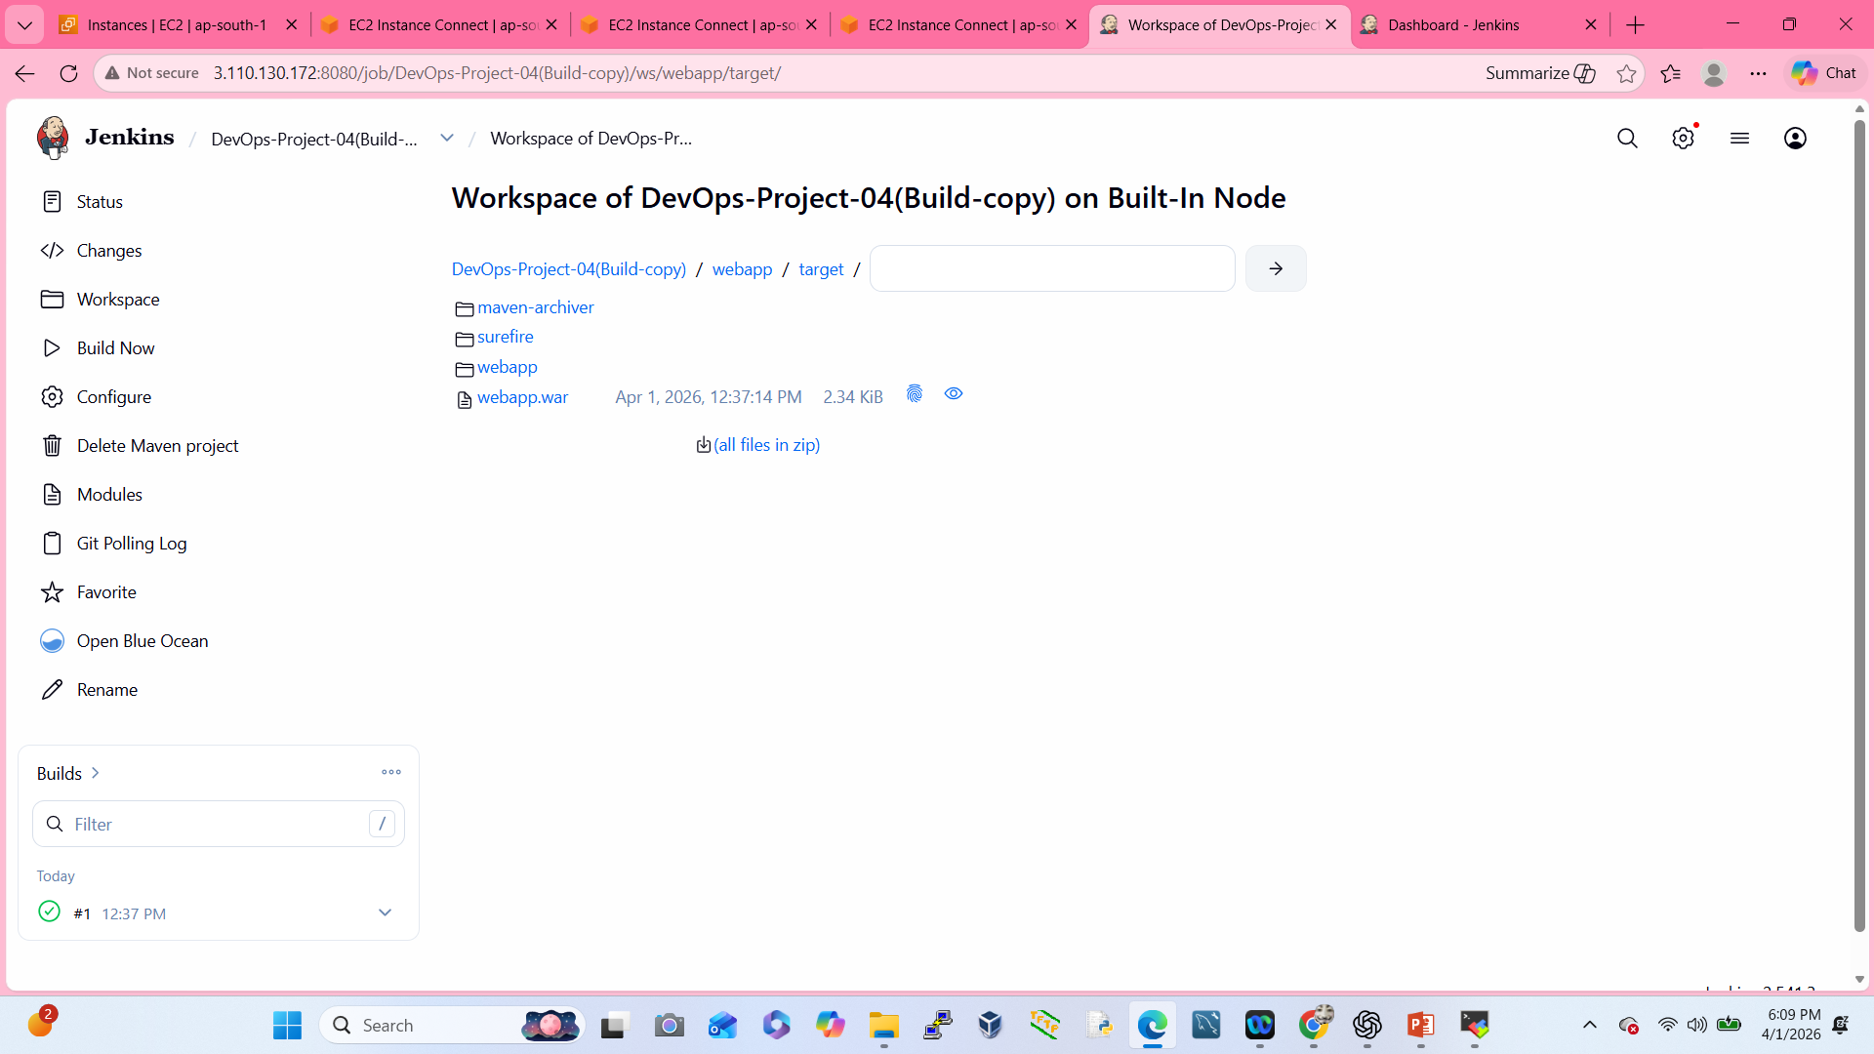
Create a Jenkins Job to Build and Copy Artifacts to Docker Server

Slide 11
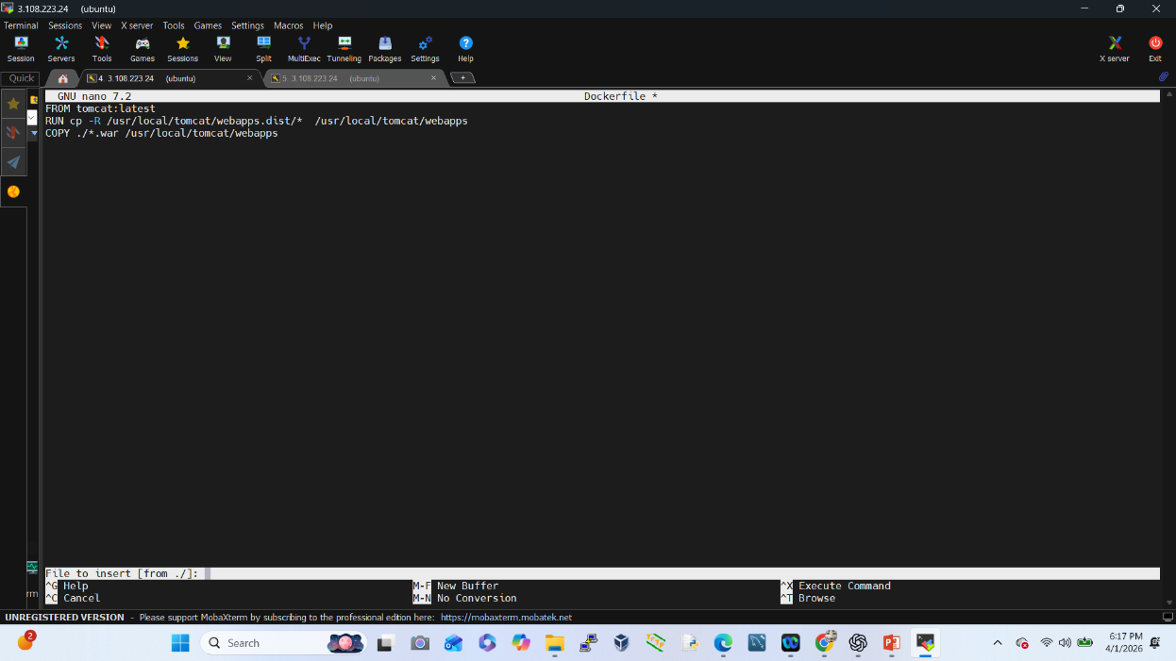
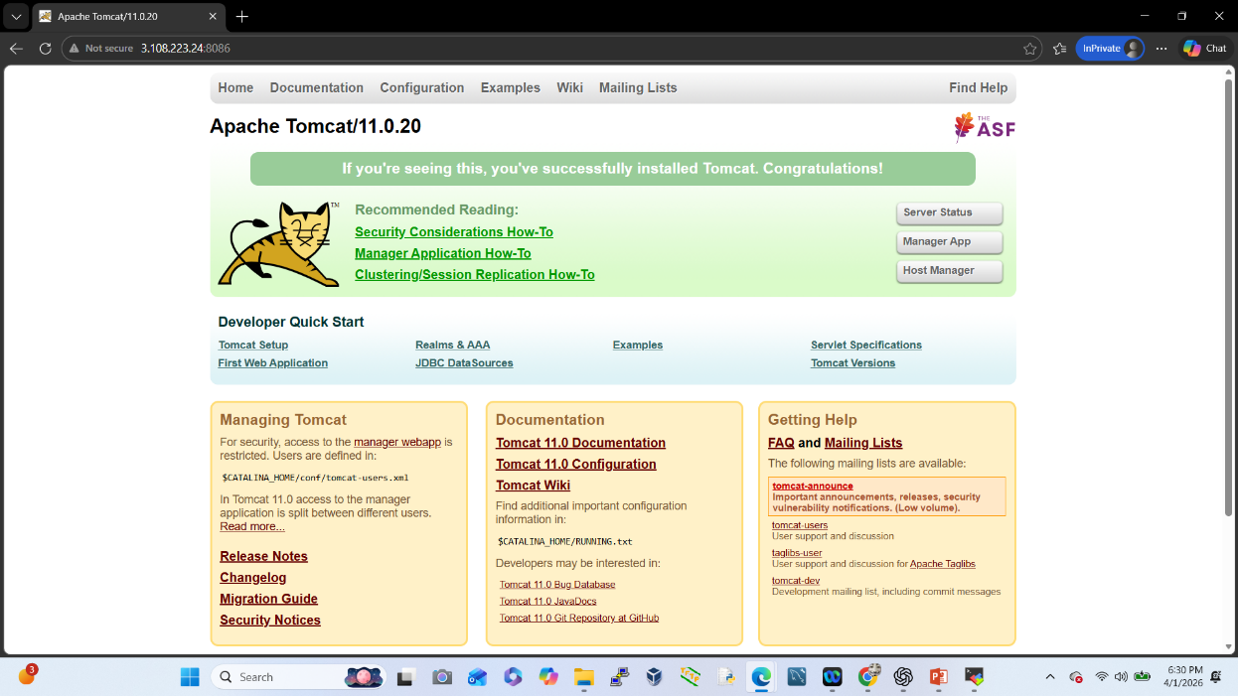
Create docker File at Docker Host to Automate Deployment

Slide 12
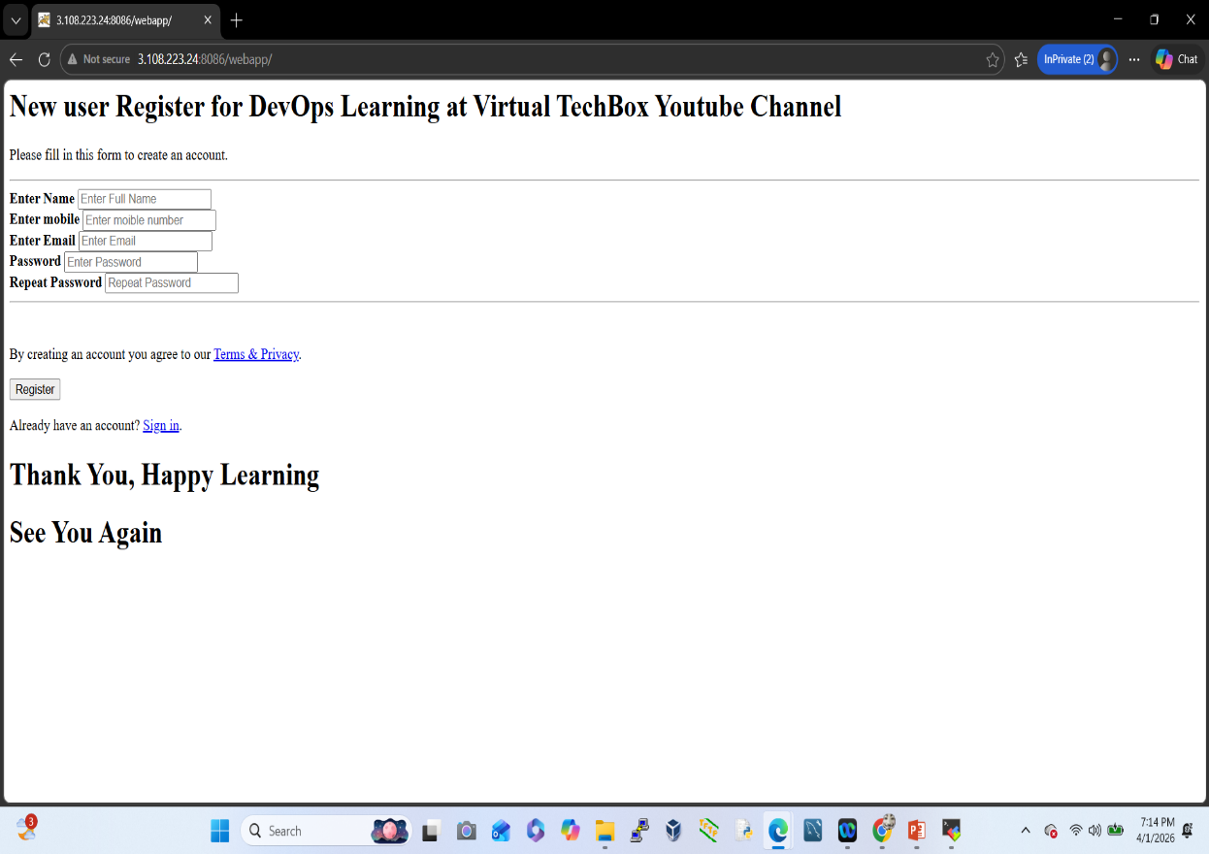
Application runs on Docker container
Go to the Configure option:- pulish over SSH
Post build action
Exec command:-
docker build –t webapp:v1 .
docker stop registerapp
docker rm registerapp
docker run -d –name registerapp –p 8086:8080 webapp:v1

